Slide 1
FAQ on Proprietary Packaging Guidelines
The purpose of this document is to address some of the frequently asked questions arising out of the Proprietary Packaging Guidelines (“Guidelines”) issued in November 2021. Therefore, this document must be read together with the Guidelines.
Is it true that all one-way glass and PET bottles, single-serve or multi-serve, must be proprietary bottle shapes?
Yes. All non-returnable, non-refillable (i.e., “one-way”) bottles must be proprietary, regardless of size (single-serve or multi-serve) or material (PET, glass, etc.) under the Proprietary Packaging Guidelines.
What happens if an Exception was previously approved by the Global Brand Council under prior guidelines to use a universal bottle for one-way bottle Coca-Cola, Sprite, and/or Fanta? Does the market have to revert to using only proprietary bottles for one-way?
In those cases, markets will be allowed to retain previously approved universal (one-way) bottles only for the period of time initially approved for the specific market.
What information should be included in the Exception Request as a business case in order to request approval to use a Universal Returnable Bottle?
All Exception Requests must be submitted through the Global Brand Standards Exception Request tool at http://standards.coke.com. In addition to the required information within the Exception Request tool and the Proprietary Packaging Guidelines, the following data should be included:
Information to be included in the Exception Request as part of the Business Case:
Market Context: Include a “Summary of the Key Business Indicators” over the last 3 years
detailing the competitive landscape and market;
Beverage Opportunity: Detail the opportunity for having a Universal Returnable Bottle based on occasions, consumer segments and size of the prize;
Why Universal Returnable Bottle: What is the Market Strategic Opportunity, and reasons for having Universal Returnable Bottle instead of Pristine or Proprietary bottle;
Proposed Action: 360 Degree plan to create value to our consumers;
Expected Results: Include Commercial, Financial and Consumer Indicators for the First Year;
Requirements for Launch: CAPEX and DME Investment;
Long Term Plan: Future investments, commercial, financial and consumer Indicators during the next 5 years; and
Bottle Data:
Percentage of glass bottles vs PET vs cans for the brand in the market where the exception is sought. If the exception is requested for a region or OU, to provide breakdown by country
Percentage of proprietary bottle shape for the relevant material (Glass or PET) vs the total mix for the same material for the brand in the country, both pre and post grant of exception request.
Plans to revert to the corresponding proprietary bottle when the granted period for the Exception has ended.

Slide 2
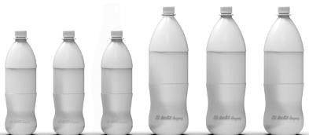
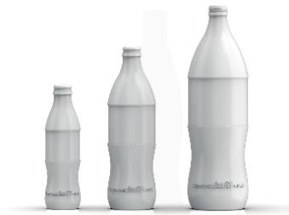
To support business case development, OUs may reach out to John Martinez from Global CCL, and the following people of the Global Category Teams: Cloe Von Krause (Sparkling Portfolio), Delia Maloney (Fanta), Shrenik Dasani (Sprite) and Miguel Saucedo (Coca-Cola).
An answer to the Exception request will be provided within two weeks following the date after all required information has been provided to the Global Brand Council.
4. Is there a preferred Universal Returnable Bottle design for adoption if an Exception request is approved?
The Company aims to have the same Universal Returnable Bottle design across all the markets. In the event that an Exception Request is approved, the Universal Returnable Bottle design that has to be used are follows:
PET Universal Returnable Bottle
Glass Universal Returnable Bottle
It is important to note that we do not have trademark rights over this Universal Returnable Bottle design, since for most Trademark Offices around the world, this bottle design is not distinctive enough to obtain trademark protection.
5. May I emboss or laser-etch “The Coca-Cola Company” or “a product of The Cola-Cola Company”
directly onto the approved Universal Returnable Bottle for use in my market?
If the Universal Returnable Bottle is intended to be applied across brands that are technically not registered under the name of The Coca-Cola Company, you may NOT use the said identifier. We suggest using the below, though this has to be confirmed with local legal, trademarks, SRA, PAC and tax.
If markets have other designs of universal bottles that were previously approved by the Global Brand Council under prior guidelines, those markets will be allowed to retain previously approved universal bottles only for the period of time initially approved for the specific market.

Slide 3
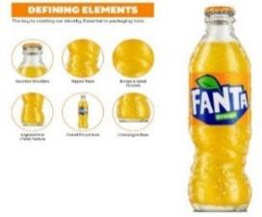
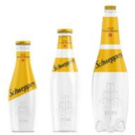
Is there any flexibility to have flat or conical panels in Coca-Cola glass Contour bottle?
No, as this departs from the well-established glass Contour Bottle shape (with a curved panel) that
has been registered as a trademark across the world. Any deviation has to be approved by the Global Brand Council and subject to the Proprietary Packaging Guidelines.
When it comes to Fanta’s proprietary bottle, what bottle are we referring to?
For Fanta case, the proprietary bottle is the Spiral Bottle, which has the following elements:
8. Regarding the rest of the global brands that are not covered by the Guidelines, are markets allowed to use universal design bottles instead of the proprietary bottles that are indicated in their corresponding Brand Standards?
Absolutely not. The use of a universal bottle instead of a proprietary bottle that is indicated within the corresponding Brand Standards Guidelines must be approved by the Global Brand Council, through the submission of an Exception Request. The Global Brand Council comprises leads from Global Marketing, Global Trademarks and Global Design Functions, and it will analyze the specific market situation (Global & local context, business case, period of time, etc.) and decide to grant or not an exception.
Besides Coca-Cola, Fanta and Sprite, there are other global brands that have bottles which come under the purview of the Global Brand Council, such as, Schweppes, Fuze Tea, Smartwater and Vitaminwater. The following are the proprietary bottles of these global brands:
SCHWEPPES¹ FUZE TEA SMARTWATER² VITAMINWATER
9. Where can I find the current versions of all the global bottles?
Below you will find the sites that contain the global proprietary bottles guidelines for each of the
global brands. Likewise, you will also find the Global Council site where an Exception Request can be submitted:
Coca-Cola:
Sprite:
Fanta:
https://dmex.coke.com/en-us/asset/59264631 https://dmex.coke.com/en-us/asset/67457540 https://standards.coke.com/fanta/
¹ For Schweppes bottle shape, please take into consideration that in most of the countries where we own Schweppes brand, the Company doesn’t have trademark rights over the Skittle bottle; however, Global Schweppes Team aims to have a premium and unified bottle across the markets, and that’s the reason why it is necessary to request an Exception if you want to deviate the bottle shape of the brand.
² For Smartwater bottle shape, please take into consideration that in most of the countries the Company doesn’t have trademark rights over the bottle; however, Global Smartwater Team aims to have a unified bottle across the markets, and that’s the reason why it is necessary to request an Exception if you want to deviate the bottle shape of the brand.

Slide 4
Schweppes:
Fuze Tea:
Global Council site:
https://standards.coke.com/schweppes/ https://standards.coke.com/fuze-tea/ https://standards.coke.com/exception-request/
10. Are bottles contained within Picasso and Global Package Design (“GPD”) tools already authorized to be used with any brand, SKU, and/or territory?
Absolutely not. Picasso and GPD are databases that serve as repositories of bottle designs; however, it doesn’t mean that (i) these designs have been approved by Technical to meet technical requirements or performance and (ii) bottles designs contained in these databases have been reviewed/approved by Legal, Design, Brand, Trademarks or the Global Council.

